Slide 1
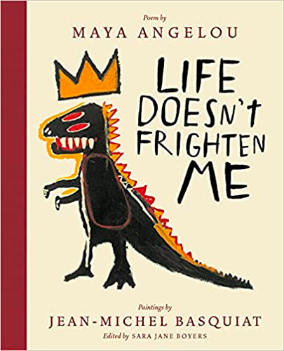
Lesson Overview

Slide 2
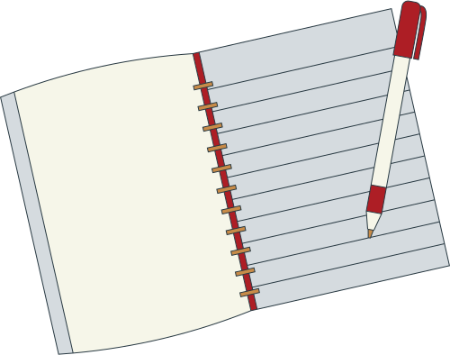
Purpose: This lesson plan is designed to use the poem “Life Doesn't Frighten Me At All” by Maya Angelou to teach elementary students about courage and the power of their own words.

Slide 3
Objective: Students will demonstrate an understanding of the poem and its message of courage by writing their own poem.

Slide 4
Materials:
Copy of the poem “Life Doesn't Frighten Me At All” by Maya Angelou
Paper and pencils
Colored markers

Slide 5
Musical Recording of Maya Angelou:

Slide 7
The chaotic brilliance of artist Jean-Michel Basquiat - Jordana Moore Saggese

Slide 9
Warm up the class by playing audio recording of Maya Angelou and encourage students to mirror the teacher's movements.
Read the poem aloud to the students.
Ask the students to identify the main theme of the poem. (courage)
Ask the students to identify the words or phrases that best represent the theme of courage. (fearless, brave, strong, unafraid, etc.)
Teach students the Orff arrangement through the rote process

Slide 10
Next Class
Invite students to take a closer look at the paintings in the book by Jean Michel Basquiat while reading the poem to the class.
Play The chaotic brilliance of artist Jean-Michel Basquiat Youtube video for students.
Ask the students to write their own poem using the identified words and phrases to express the message of courage.
Ask the students to illustrate their poems using colored markers.
Have each student present their poem to the class and explain their illustrations.

Slide 11
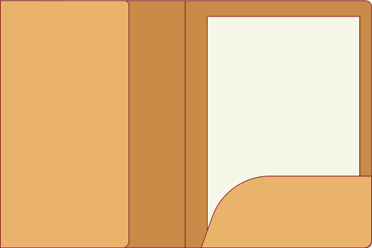
Closure:
Discuss the power of using one’s own words to express emotions and the importance of courage.
Remind the students that they can always use their words to express their courage and strength, no matter what they may face in life.

